Slide 1
We wszechświecie jest więcej gwiazd niż ziaren piasku na Ziemi.

Slide 2
ODBLOKUJ PRZEPŁYW DANYCH ASYNCHRONICZNOŚĆ Z UŻYCIEM REACT PHP

Slide 3
GET THE REPO
git clone git@github.com:Przemyslaw-Wrobel/react-workshop.git

Slide 4
EVENT LOOP
CORE COMPONENTS
STREAMS
PROMISES

Slide 5

IS IT GOOD TO USE AN INFINITE LOOP?

Slide 6
EVENT LOOP
Future ticks
signals
Timers
Periodic Timers
streams
ticks
Read Streams
Write Streams
Signals*
timers

Slide 7

ELEVATORS APPLICATION

Slide 8
ELEVATORS APPLICATION FLOW
APP START
CLIENT SCHEDULED
CLIENT ENTERS
THE BUILDING
LOOKING FOR
AN ELEVATOR
ENTERS THE ELEVATOR
MOVES UP
LEAVES THE ELEVATOR
DOES HIS STUFF
LOOKING FOR
AN ELEVATOR
READY
ENTERS THE ELEVATOR
MOVES DOWN
LEAVES THE ELEVATOR
AND THE BUILDING

Slide 9
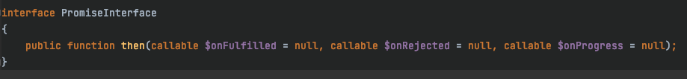
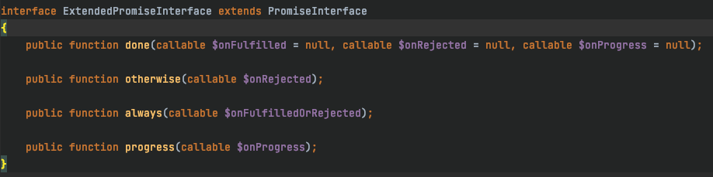
PROMISES
A promise represents the eventual value returned from the single completion of an operation. A promise may be in one of the three states:
UNFULLFILLED
RESOLVED
REJECTED

Slide 10
JOBS APPLICATION
turn sync into async

Slide 11
Job
Id
Name
Query
Interval

Slide 12
Dependencies
MySQL
External Web Service
Redis

Slide 13
Flow
APP START
GET JOBS
MYSQL
SCHEDULE JOB(S)
EXECUTE JOB
MYSQL
EXECUTE QUERY
HTTP
SEND REPORT
REDIS
COLLECT STATS

Slide 14
TODO GET JOBS EXECUTE QUERY SEND REPORT COLLECT STATS
GET JOBS
EXECUTE QUERY
EXECUTE QUERY
SEND REPORT
SEND REPORT
COLLECT STATS
COLLECT STATS
RESCHEDULE
RESCHEDULE
JOB1
streams
timers
JOB1
JOB2
JOB2

Slide 15
TODO GET JOBS EXECUTE QUERY SEND REPORT COLLECT STATS
RECEIVE MYSQL DATA
EXECUTE QUERY
EXECUTE QUERY
QUERY MYSQL
SCHEDULE JOBS
SEND REPORT
SEND REPORT
COLLECT STATS
COLLECT STATS
RESCHEDULE
RESCHEDULE
JOB1
GET JOBS
streams
timers
JOB1
GET JOBS
JOB2
JOB2

Slide 16
TODO GET JOBS EXECUTE QUERY SEND REPORT COLLECT STATS
RECEIVE MYSQL DATA
EXECUTE QUERY
RECEIVE MYSQL DATA
SCHEDULE JOBS
QUERY MYSQL
SEND REPORT
COLLECT STATS
JOB1 QUERY
RESCHEDULE
JOB1 QUERY
JOB1
JOB1
GET JOBS
streams
timers
GET JOBS
JOB2
JOB2
JOB2 QUERY
JOB2 QUERY
RESCHEDULE
COLLECT STATS
SEND REPORT
RECEIVE MYSQL DATA
QUERY MYSQL
EXECUTE QUERY

Slide 17
TODO GET JOBS EXECUTE QUERY SEND REPORT COLLECT STATS
EVERYTHING ASYNCHRONOUS?
AWESOME?

Slide 18



With great power comes great responsibility

Slide 19
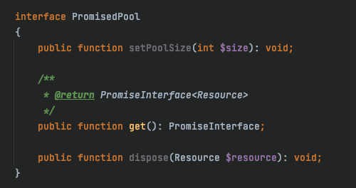
ISSUES FOUND UNLIMITED JOBS MYSQL PROTOCOL IS SEQUENTIAL
POOL PATTERN TO THE RESCUE!
EXECUTOR POOL
LIMITS NUMBER OF ACTIVE JOBS
QUERY EXECUTOR POOL
LIMITS NUMBER OF ACTIVE QUERIES

Slide 20
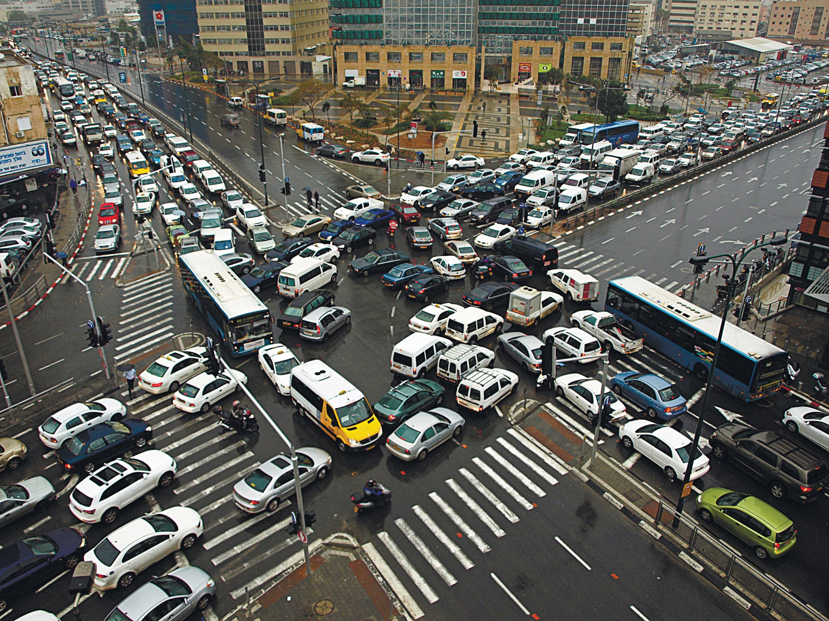


Slide 21
HOW TO NOT BLOCK
USE DEDICATED LIBRARIES FOR NETWORK OPERATIONS
SPLIT YOUR CODE INTO SMALLER CHUNKS AND TICK AFTER EVERY STEP
CONSIDER MOVING TIME CONSUMING OPERATIONS TO EXTERNAL SERVICE
MOVE TIME CONSUMING OPERATIONS TO SEPARATED PROCESSES

Slide 22
THE TIME HAS COME
QUESTIONS, ANSWERS
AND
EXCUSES

Slide 23


